Slide 1
Chapter 3: Information Representation
Introduction
Notes:
Before we can begin programming in assembly, we must learn about number and character representation at the lower levels.

Slide 2
Chapter 3 Objectives
Fundamentals of numerical data representation in digital computers
Learn to convert between various radix systems
Overflow and truncation errors can occur
Fundamentals of floating-point representation
Review popular character codes
Notes:
The objective of this chapter are:
To understand the fundamentals of numerical data representation and manipulation in digital computers.
To master the skill of converting between various radix systems.
To understand how errors can occur in computations because of overflow and truncation.
To understand the fundamental concepts of floating-point representation.
And to gain familiarity with the most popular character codes.

Slide 3
Introduction
bit - most basic unit of information in a computer
“on” or “off”
Sometimes “high” or “low” voltage
byte is a group of eight bits
A byte is the smallest addressable unit
“addressable” means it can be retrieved from its location in memory.
Notes:
A bit is the most basic unit of information in a computer.
It is a state of “on” or “off” in a digital circuit.
Sometimes these states are “high” or “low” voltage instead of “on” or “off..”
A byte is a group of eight bits.
A byte is the smallest possible addressable unit of computer storage.
The term, “addressable,” means that a particular byte can be retrieved according to its location in memory.

Slide 4
Introduction
word is a contiguous group of bytes
Words can be any number of bits or bytes
Word sizes of 16, 32, or 64 bits are most common.
Word-addressable system, a word is the smallest addressable unit of storage.
nibble (or nybble) is a group of four bits
Bytes consist of two nibbles:
a high-order nibble
a low-order nibble
Notes:
A word is a contiguous group of bytes.
Words can be any number of bits or bytes.
Word sizes of 16, 32, or 64 bits are most common.
In a word-addressable system, a word is the smallest addressable unit of storage.
A group of four bits is called a nibble (or nybble).
Bytes, therefore, consist of two nibbles: a “high-order nibble,” and a “low-order” nibble.

Slide 5
Positional Numbering Systems
Bytes store numbers using the position of each bit to represent a power of 2
The binary system is also called the base-2 system
Our decimal system is the base-10 system
Any integer quantity can be represented exactly using any base (or radix)
Notes:
Bytes store numbers using the position of each bit to represent a power of 2.
The binary system is also called the base-2 system.
Our decimal system is the base-10 system. It uses powers of 10 for each position in a number.
Any integer quantity can be represented exactly using any base (or radix).

Slide 6
Positional Numbering Systems
The decimal number 947 in powers of 10 is:
The decimal number 5836.47 in powers of 10 is:
9 × 10 ² + 4 × 10 ¹ + 7 × 10 ⁰
5 × 10 ³ + 8 × 10 ² + 3 × 10 ¹ + 6 × 10 ⁰ + 4 × 10 ⁻¹ + 7 × 10 ⁻²

Slide 7
Positional Numbering Systems
The binary number 11001 in powers of 2 is:
The base is denoted by a subscript when not 10
Sometimes, the subscript 10 is added for emphasis:
11001₂ = 25₁₀
1 × 2 ⁴ + 1 × 2 ³ + 0 × 2 ² + 0 × 2 ¹ + 1 × 2 ⁰
= 16 + 8 + 0 + 0 + 1 = 25
Notes:
Here the binary number 11001 in powers of 2 is:
The base is denoted by a subscript when not 10.
However sometimes it is added for emphasis.
Because binary numbers are the basis for all data representation in digital computer systems, it is important that you become proficient with this radix system.
Your knowledge of the binary numbering system will enable you to understand the operation of all computer components as well as the design of instruction set architectures.

Slide 8
Decimal to Radix Conversions
Every integer value can be represented exactly using any radix system
Two methods for radix conversion:
Subtraction method
Division remainder method
Subtraction method
more intuitive
cumbersome
Notes:
In an earlier slide, we said that every integer value can be represented exactly using any radix system.
You can use either of two methods for radix conversion: the subtraction method and the division remainder method.
The subtraction method is more intuitive, but cumbersome. It does, however reinforce the ideas behind radix mathematics.

Slide 9
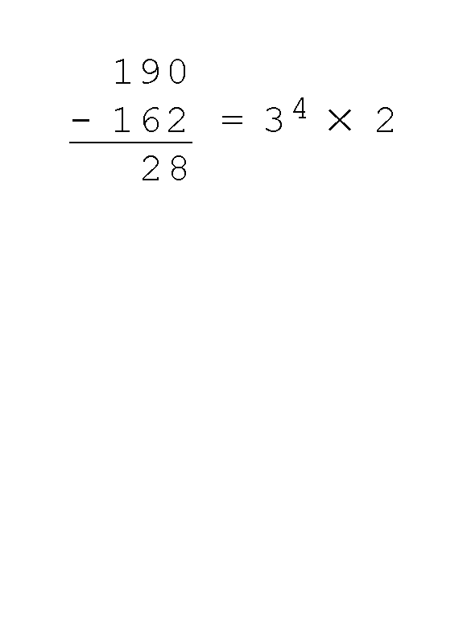
Decimal to Radix Conversions – Subtraction Method
Convert decimal number 190 to base 3
3 ⁵ = 243 too large
Start with 3 ⁴ = 81
81 × 2 = 162
Write down 2 (81s)
Subtract 162 from 190
Leaving 28
3 ⁵ = 243 3 ⁴ = 81 3 ³ = 27 3 ² = 9 3 ¹ = 3 3 ⁰ = 1
Notes:
Let’s review the subtraction method for base three.
First we need to know the powers of 3 for the range we are working in
Suppose we want to convert the decimal number 190 to base 3.
We see that 3 ⁵ = 243 is too large. The largest power of 3 that we need is therefore 3 ⁴ = 81, and 81 × 2 = 162.
We write down the 2 – this represents the 81s column. Just like when we are in the decimal system we refer to the ones, tens, & hundreds columns.
We subtract 162 from 190, leaving 28.

Slide 10
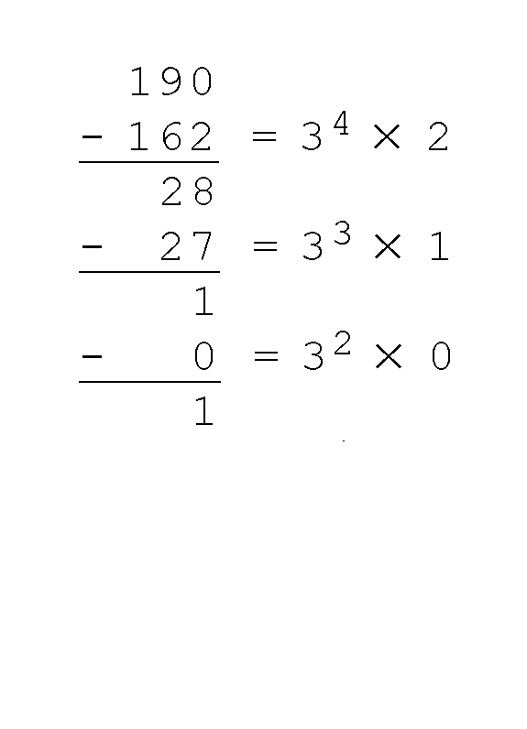
Decimal to Binary Conversions – Subtraction Method
Converting 190 to base 3...
Next 3 ³ = 27
27 X 1 = 27
Write down 1 (27s)
Subtract 27
Leaving 1
Next 3 ² = 9 too large
9 X 0 = 0
Write down 0 (nines)
Subtract 0
Leaving 1
3 ⁵ = 243 3 ⁴ = 81 3 ³ = 27 3 ² = 9 3 ¹ = 3 3 ⁰ = 1
Notes:
Converting 190 to base 3...
The next power of 3 is 3 ³ = 27. We’ll need one of these, so we write down the numeral 1 which represents the 27s.
Then we subtract 27 and write down the numeral 1 in our result.
The next power of 3, 3 ² = 9, is too large, but we have to assign a placeholder of zero for the 9s column, subtract 0 and carry down the 1.

Slide 11
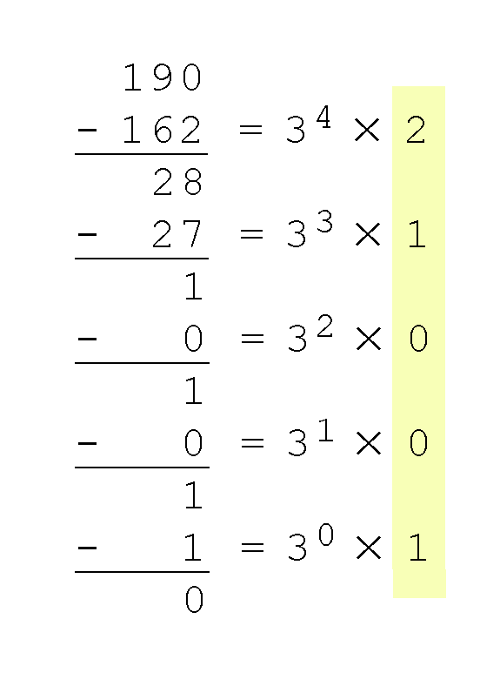
Decimal to Radix Conversions– Subtraction Method
Converting 190 to base 3...
Next 3 ¹ = 3 too large
3 x 0 = 0
Write down 0 (threes)
Subtract 0
Leaving 1
Last 3 ⁰ = 1
1 x 1 = 0
Write down 1 (ones)
Result, reading top to bottom
190₁₀ = 21001₃
Notes:
Next 3 ¹ = 3 too large
3 X 0 = 0
Write down 0 – placeholder for the 3s column
Subtract 0 - Leaving 1
Last 3 ⁰ = 1, is the ones column, and it gives us a difference of zero.
When the difference is zero and all of the positions are filled we are done.
Our result, reading from top to bottom is:
190₁₀ = 21001₃

Slide 12
Decimal to Radix Conversions - Division Method
Mechanical and easy
Successive division by a base is equivalent to successive subtraction by powers of the base
Apply division remainder method to
convert 190 in decimal to base 3
Notes:
Another method of converting integers from decimal to some other radix uses division.
This method is mechanical and easy.
It employs the idea that successive division by a base is equivalent to successive subtraction by powers of the base.
Let’s use the division remainder method to again convert 190 in decimal to base 3.

Slide 13
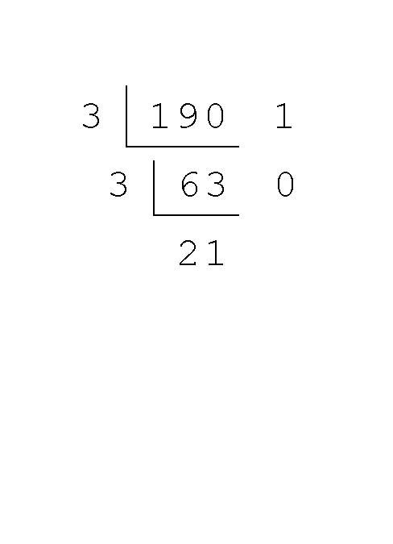
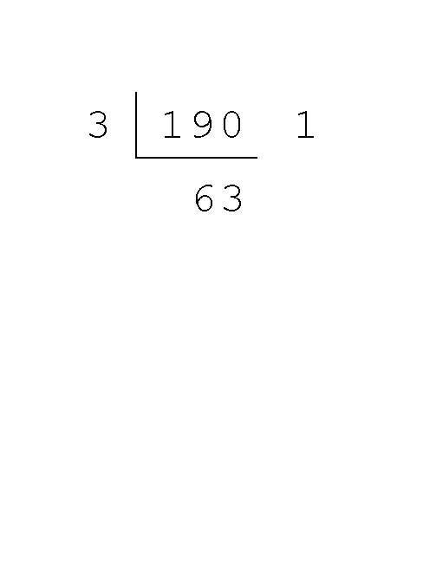
Decimal to Radix Conversions – Division Method
Converting 190 to base 3...
Divide the by the radix
Divide 190 by 3
Yields 63 with remainder of 1
Record quotient and remainder
Divide 63 by 3
Yields 21 and remainder is 0
Notes:
First we take the number that we wish to convert and divide it by the radix in which we want to express our result.
In this case, 190 divided by 3 is 63 with a remainder of 1.
Record the quotient and the remainder.
Then divide 63 by 3 which yields 21 with a remainder of 0

Slide 14
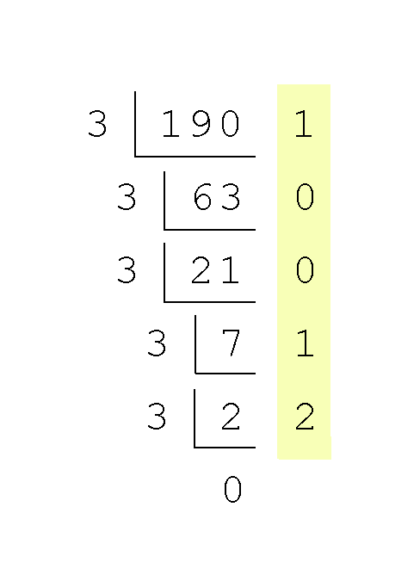
Decimal to Radix Conversions – Division Method
Converting 190 to base 3...
Continue until quotient is 0
Note final calculation:
3 divides into 2 zero times with a remainder of 2
Result, reading bottom to top
190₁₀ = 21001₃
Notes:
Continue in this way until the quotient is zero.
In the final calculation, we note that 3 divides 2 zero times with a remainder of 2.
Our result, reading from bottom to top is:
190₁₀ = 21001₃
_{Yay – we got the same answer!}

Slide 15
Decimal to Binary Conversions - Fractions
Fractional values can be approximated in all base systems
Fractions do not necessarily have exact representations under all radices
½ is
Exact representation in binary and decimal systems
Not exact in the ternary (base 3) numbering system
Notes:
Fractional values can only be approximated in all base systems.
Unlike integer values, fractions do not necessarily have exact representations under all radices.
The quantity ½ is exactly representable in the binary and decimal systems, but is not in the ternary (base 3) numbering system

Slide 16
Decimal to Radix Conversions - Fractions
Fractional decimal values have nonzero digits to the right of the decimal point.
Fractional values of other radix systems have nonzero digits to the right of the radix point.
Numerals to the right of a radix point represent negative powers of the radix:
0.47₁₀ = 4 × 10 ⁻¹ + 7 × 10 ⁻²
0.11₂ = 1 × 2 ⁻¹ + 1 × 2 ⁻²
= ½ + ¼
= 0.5 + 0.25 = 0.75
Notes:
In the decimal system, the fractional decimal values have nonzero digits to the right of the decimal point.
In other bases systems, the fractional radix values have nonzero digits to the right of the radix point.
Just like the digits to the left of the radix point represent positive powers of the radix, the digits to the right of the radix point represent negative powers of the radix as shown here.

Slide 17
Decimal to Radix Conversions - Fractions
Two methods:
subtraction method
multiplication method - easier
Subtraction method for fractions
identical to the subtraction method for whole numbers
subtract negative powers of the radix
Start with the largest value first
n ⁻¹, where n is our radix
work down using larger negative exponents
Notes:
As with whole-number conversions, you can use either of two methods: a subtraction method and an easy multiplication method.
The subtraction method for fractions is identical to the subtraction method for whole numbers. Instead of subtracting positive powers of the target radix, we subtract negative powers of the radix.
We always start with the largest value first, n ⁻¹, where n is our radix, and work our way along using larger negative exponents.

Slide 18
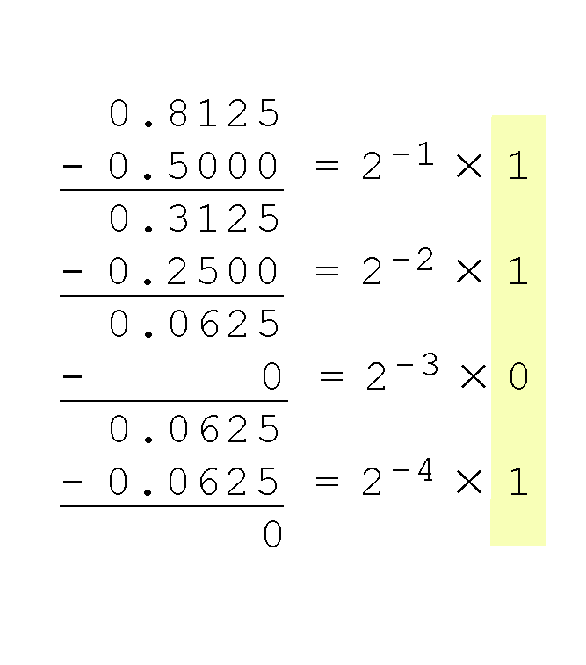
Decimal to Radix Conversions – Fractions – Subtraction Method
Example of subtraction method
Convert decimal 0.8125 to binary
Subtract negative powers of 2
Result:
reading top to bottom
0.8125₁₀ = 0.1101₂
Method works with any base - not just binary
Notes:
The calculation to the right is an example of using the subtraction method to convert the decimal 0.8125 to binary. Here negative powers of 2 are subtracted until there is zero remainder or the desired number of digits is reached.
Our result, reading from top to bottom is:
0.8125₁₀ = 0.1101₂
Of course, this method works with any base, not just binary, by using negative powers of the radix.

Slide 19
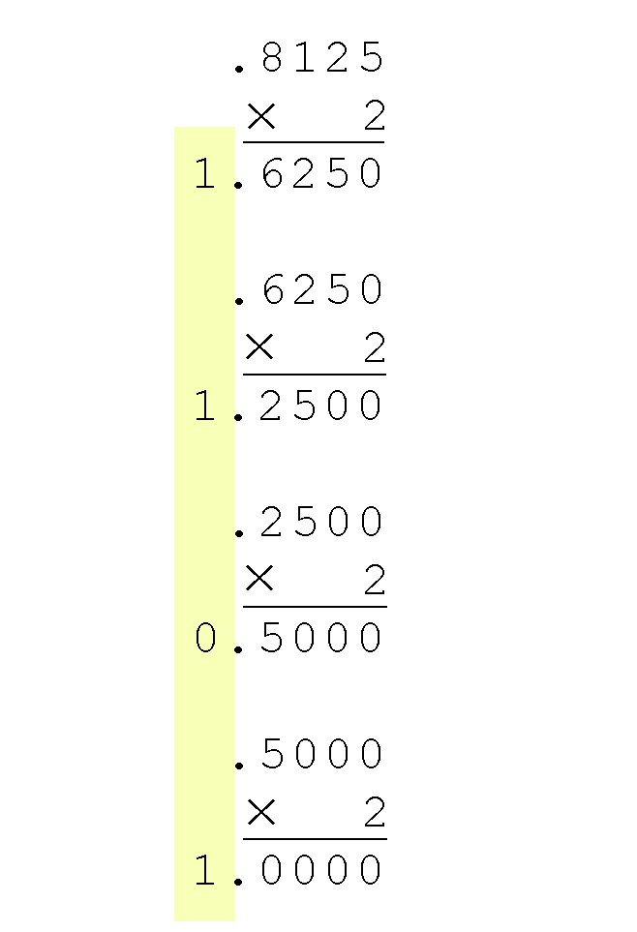
Decimal to Radix Conversions – Fractions – Multiplication Method
Example of multiplication method
Convert decimal 0.8125 to binary
Multiply by the radix: 2.
Product carries into ones column
Ignore value in ones column at when multiplying
Continue multiplying fractional part by the radix until the fractional product is 0
Result:
reading top to bottom
0.8125₁₀ = 0.1101₂
Method also works with any base
Notes:
Using the multiplication method to convert the decimal 0.8125 to binary, we multiply by the radix 2.
The first product carries into the units place.
Ignoring the value in the ones column when multiplying, continue multiplying each fractional part by the radix
You are finished when the product is zero, or until you have reached the desired number of binary places.
Our result, reading from top to bottom is:
0.8125₁₀ = 0.1101₂
This method also works with any base. Just use the target radix as the multiplier.

Slide 20
Data Representation in Computers
Every integer value can be represented exactly using any radix system
Fractional values can be approximated in all base systems
All numbers and characters represented by sequences of 0 & 1
Binary, Octal (base 8) and Hexadecimal
Common Bases
Notes:
So remember, every integer can be represented exactly in any radix system.
However, fractional values can only be approximated.
All numbers and characters in a computer, must be represented by 0s and 1s, so we must become fluent in binary, octal and hexadecimal number representation and character codes.

